Slide 1
Contemporary chielan art. By Artists Associated with the University of Chile (5-20006)

Slide 2
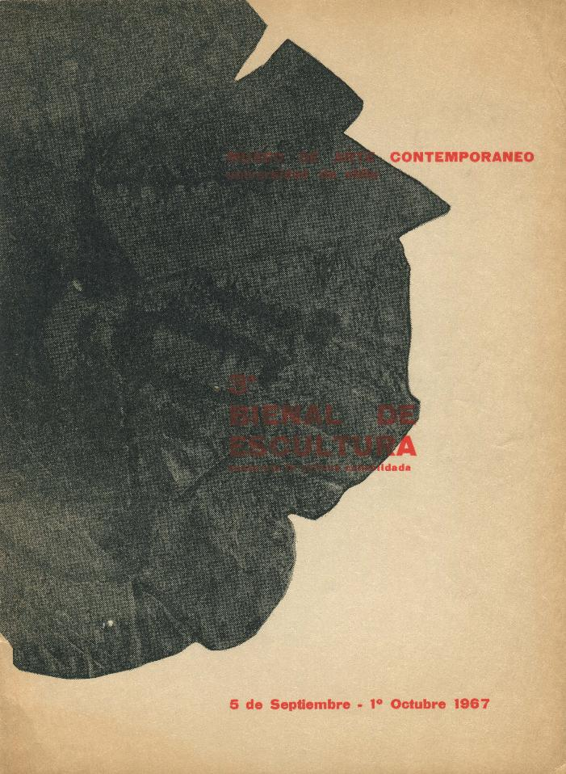
Tercera Bienal de escultura (5-20007)

