Slide 1
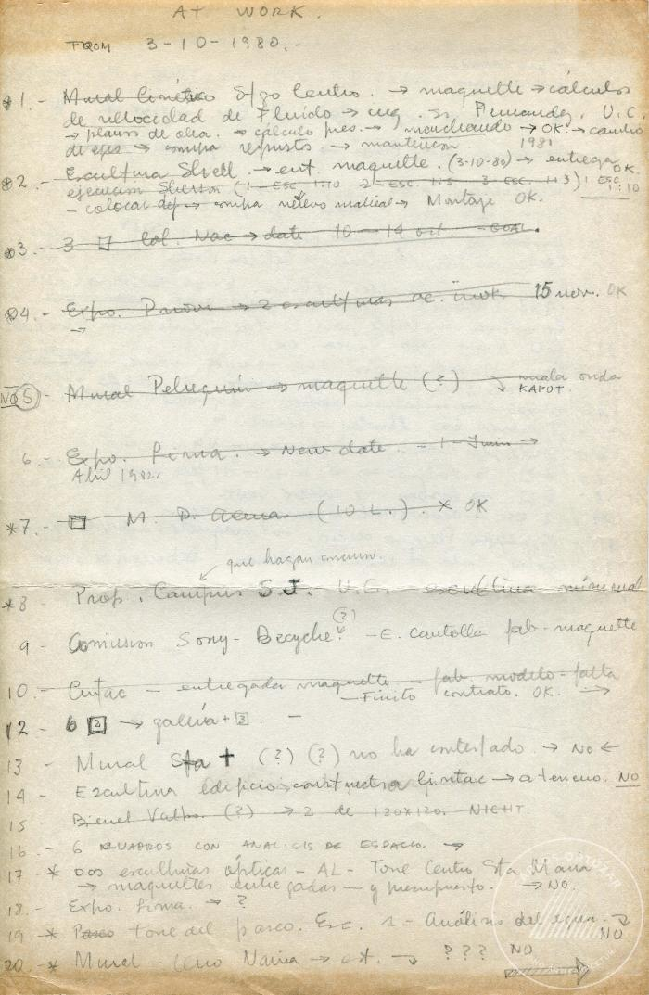
At Work from 3-10-1980 (6-20005)

